Slide 1
INFO 656-01 Fall 2020 Neural Networks
Week 9
Amir Imani

Slide 2
Neural networks were first proposed in 1944 by Warren McCullough and Walter Pitts.
Modeled loosely on the human brain, a neural net consists of thousands or even millions of simple processing nodes that are “densely” interconnected
Notes:
neural networks, which have been going in and out of fashion for more than 70 years.

Slide 3
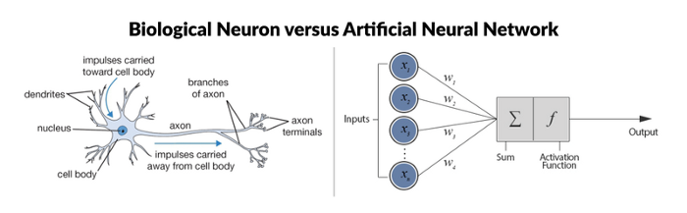
Artificial Neuron/Perceptron
What has changed since then? More data, faster computation (GPUs), model improvement (ReLu, drop-out, optimizers, etc)
https://medium.com/swlh/learning-paradigms-in-neural-networks-30854975aa8d
Notes:
A neuron is a mathematical function modeled on the working of biological neurons
It is an elementary unit in an artificial neural network (1957 Frank Rosenblatt)
In the biological process, a dendrite first receives some sort of impulse. That impulse is then translated across an axon and finally released at an axon terminal. These three steps are similar to the three layers that comprise an artificial neuron. The first layer is the input layer in which we put in values that we will use to predict. The second layer is called the hidden layer in which we have some activation function that will transform our inputs in addition to summing them together. The third layer is our output layer in which we see the observable result of our neuron in a format in which we expect.
It is an elementary unit in an artificial neural network
One or more inputs are separately weighted
Inputs are summed and passed through a nonlinear function to produce output
Every neuron holds an internal state called activation signal
Each connection link carries information about the input signal
Every neuron is connected to another neuron via connection link

Slide 4
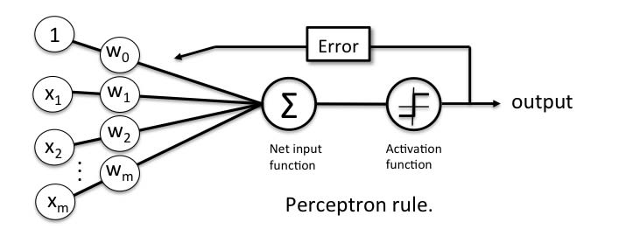

Perceptron Learning Rule
Notes:
Perceptron Learning Rule states that the algorithm would automatically learn the optimal weight coefficients. The input features are then multiplied with these weights to determine if a neuron fires or not.
The Perceptron receives multiple input signals, and if the sum of the input signals exceeds a certain threshold, it either outputs a signal or does not return an output.
In the Perceptron Learning Rule, the predicted output is compared with the known output. If it does not match, the error is propagated backward to allow weight adjustment to happen.

Slide 5
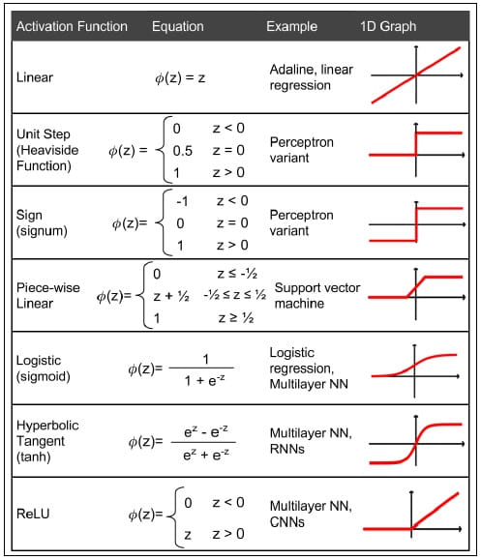
Activation Functions
https://www.simplilearn.com/what-is-perceptron-tutorial
Notes:
The activation function applies a step rule (convert the numerical output into +1 or -1) to check if the output of the weighting function is greater than zero or not.
Two additional major benefits of ReLUs are sparsity and a reduced likelihood of vanishing gradient.
Issues with ReLu
Non-differentiable at zero - Non-differentiable at zero means that values close to zero may give inconsistent or intractable results.
Non-zero centered - Being non-zero centered creates asymmetry around data (only positive values handled), leading to the uneven handling of data.
Unbounded - The output value has no limit and can lead to computational issues with large values being passed through.
Dying ReLU problem - When learning rate is too high, Relu neurons can become inactive and “die.”

Slide 6
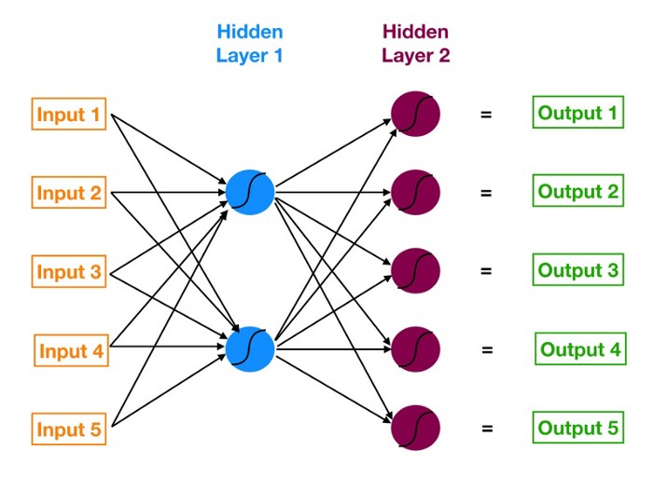
How a Neural Network works?
Notes:
5 input, 5 output, 2 hidden layers
What are nodes?
A node, also called a neuron or Perceptron, is a computational unit that has one or more weighted input connections, a transfer function that combines the inputs in some way, and an output connection.
What are layers?
The input layer is contains your raw data (you can think of each variable as a 'node').
The hidden layer(s) are where the black magic happens in neural networks. Each layer is trying to learn different aspects about the data by minimizing an error/cost function.
Output Layer: A layer of nodes that produce the output variables.
# of nodes in the input layer is determined by the dimension of the data - # of nodes in the output layer is determined by the number of classes
there are terms used to describe the shape and capability of a neural network; for example:
Size: The number of nodes in the model.
Width: The number of nodes in a specific layer.
Depth: The number of layers in a neural network.
Capacity: The type or structure of functions that can be learned by a network configuration. Sometimes called “representational capacity“.
Architecture: The specific arrangement of the layers and nodes in the network.
When a neural net is being trained, all of its weights and thresholds are initially set to random values. Training data is fed to the bottom layer — the input layer — and it passes through the succeeding layers, getting multiplied and added together in complex ways, until it finally arrives, radically transformed, at the output layer. During training, the weights and thresholds are continually adjusted until training data with the same labels consistently yield similar outputs.
The training process of a neural network, at a high level, is like that of many other data science models — define a cost function and use gradient descent optimization to minimize it.
In a neural network, changing the weight of any one connection (or the bias of a neuron) has a reverberating effect across all the other neurons and their activations in the subsequent layers.
That’s because each neuron in a neural network is like its own little model.
We want to find the set of weights (remember that each connecting line between any two elements in a neural network houses a weight) and biases (each neuron houses a bias) that minimize our cost function — where the cost function is an approximation of how wrong our predictions are relative to the target outcome. Like MSE
Remember that forward propagation is the process of moving forward through the neural network (from inputs to the ultimate output or prediction). Backpropagation is the reverse. Except instead of signal, we are moving error backwards through our model.

Slide 7
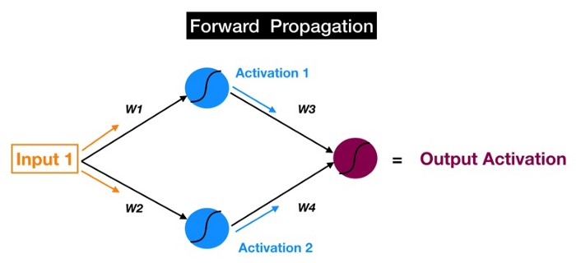
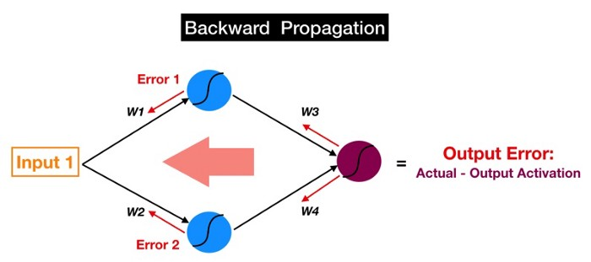
Forward and Backward Propagation
Notes:
The training process of a neural network, at a high level, is like that of many other data science models — define a cost function and use gradient descent optimization to minimize it.
In a neural network, changing the weight of any one connection (or the bias of a neuron) has a reverberating effect across all the other neurons and their activations in the subsequent layers.
That’s because each neuron in a neural network is like its own little model.
We want to find the set of weights (remember that each connecting line between any two elements in a neural network houses a weight) and biases (each neuron houses a bias) that minimize our cost function — where the cost function is an approximation of how wrong our predictions are relative to the target outcome. Like MSE
Remember that forward propagation is the process of moving forward through the neural network (from inputs to the ultimate output or prediction). Backpropagation is the reverse. Except instead of signal, we are moving error backwards through our model.
If a particular neuron has a much larger error than all the other ones, then tweaking the weights and bias of our offending neuron will have a greater impact on our model’s total error than fiddling with any of the other neurons.
These weights and biases across the entire network are also the dials that we tweak to change the predictions made by the model.
That neuron will quickly and efficiently point the finger at the upstream colleague (or colleagues) who is most at fault for causing the error

Slide 8
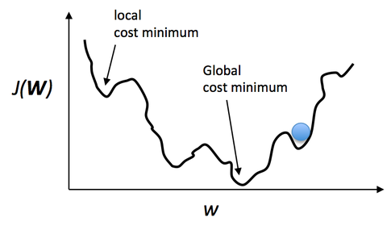
Optimizers
Gradient Descent
Stochastic Gradient Descent
Mini-Batch Gradient Descent
Momentum, AdaGrad, AdaDelta, …
Adam (Adaptive Moment Estimation)
https://miro.medium.com/max/600/1*_osB82GKHBOT8k1idLqiqA.gif
Notes:
Gradient Descent is the most basic but most used optimization algorithm. It’s used heavily in linear regression and classification algorithms. Backpropagation in neural networks also uses a gradient descent algorithm.
Advantages:
Easy computation.
Easy to implement.
Easy to understand.
Disadvantages:
May trap at local minima.
Weights are changed after calculating gradient on the whole dataset. So, if the dataset is too large than this may take years to converge to the minima.
Requires large memory to calculate gradient on the whole dataset.
----
The learning rate is perhaps the most important hyperparameter. If you have time to tune only one hyperparameter, tune the learning rate.
the learning rate is a configurable hyperparameter used in the training of neural networks that has a small positive value, often in the range between 0.0 and 1.0.
The learning rate controls how quickly the model is adapted to the problem. Smaller learning rates require more training epochs given the smaller changes made to the weights each update, whereas larger learning rates result in rapid changes and require fewer training epochs.
A learning rate that is too large can cause the model to converge too quickly to a suboptimal solution, whereas a learning rate that is too small can cause the process to get stuck.
----
SGD - It’s a variant of Gradient Descent. It tries to update the model’s parameters more frequently.
Advantages:
Frequent updates of model parameters hence, converges in less time.
Requires less memory as no need to store values of loss functions.
May get new minima’s.
Disadvantages:
High variance in model parameters.
May shoot even after achieving global minima.
To get the same convergence as gradient descent needs to slowly reduce the value of learning rate.
Minibatch: It updates the model parameters after every batch. So, the dataset is divided into various batches and after every batch, the parameters are updated.
Advantages:
Frequently updates the model parameters and also has less variance.
Requires medium amount of memory.
All types of Gradient Descent have some challenges:
Choosing an optimum value of the learning rate. If the learning rate is too small than gradient descent may take ages to converge.
Have a constant learning rate for all the parameters. There may be some parameters which we may not want to change at the same rate.
May get trapped at local minima.
Adam: Adam (Adaptive Moment Estimation) works with momentums of first and second order. The intuition behind the Adam is that we don’t want to roll so fast just because we can jump over the minimum, we want to decrease the velocity a little bit for a careful search.
Advantages:
The method is too fast and converges rapidly.
Rectifies vanishing learning rate, high variance.
Disadvantages:
Computationally costly.

Slide 9
Why have multiple layers?
A single-layer neural network can only be used to represent linearly separable functions.
A Multilayer Perceptron can be used to represent convex regions.
How many layers and nodes to use? Experimentation, Intuition, Literature
Notes:
First point: This means very simple problems where, say, the two classes in a classification problem can be neatly separated by a line.
But Most problems that we are interested in solving are not linearly separable.
Second point: This means that in effect, they can learn to draw shapes around examples in some high-dimensional space that can separate and classify them, overcoming the limitation of linear separability.

Slide 10
Why using Neural Nets?
Non-linear models for classification and regression
Work well for very large datasets
Non-convex optimization
MANY variants (Convolutional nets, Recurrent neural networks, Long-Short-Term Memory, Generative Adversarial Networks, reinforcement learning, ...)
BUT
Notoriously slow to train – need for GPUs
Requires preprocessing → similar to linear models, unlike trees

Slide 11
Frameworks
TensorFlow - checkout http://playground.tensorflow.org/
PyTorch / Torch
Chainer
CNTK
MXNET
DL4J
…
Notes:
TensorFlow is inarguably one of the most popular deep learning frameworks. Developed by the Google Brain team, TensorFlow supports languages such as Python, C++, and R to create deep learning models along with wrapper libraries. It is available on both desktop and mobile.
Torch is a scientific computing framework that offers broad support for machine learning algorithms. In recent years, PyTorch has seen a high level of adoption within the deep learning framework community and is considered to be quite the competitor to T
Autodiff
GPU support
Optimization and inspection of computation graph
on-the-fly generation of the graph (?)
distribution over muliple GPUs and/or cluster (?)
ensorFlow.

Slide 12
Questions?

